Slide 1
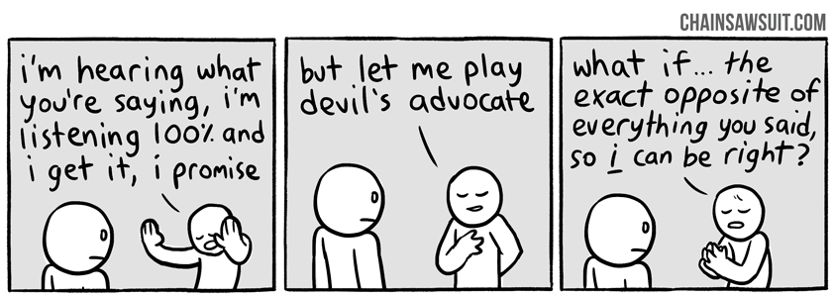
Countering: “Pushing Against” a Text

Slide 2
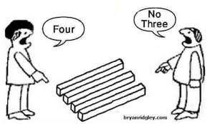
To counter is to “push back” against the text in some way (disagree with it, challenge something it says, or interpret it differently.)
COUNTERING-

Slide 3
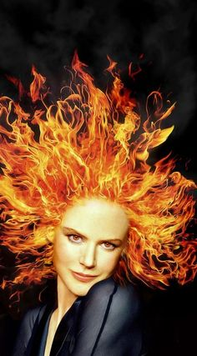
CLAIM: THE BEST WAY TO PICK UP GUYS IS TO LIGHT YOUR HAIR ON FIRE.

Slide 4
Quick Write: Counter one or more of the pieces of evidence provided for the claim, the best way to pick up guys is to light your hair on fire.
1.You will be sparkly, bright and absolutely radiating.
2. Your guy will feel like a knight in shining armor, when he rescues you.
3. The crisis will invoke such a deep sympathy for you that he will be unable to ever let you go.
4. You will be flaming hot!

Slide 5
Philosophical Chairs
Prompt: Should schools monitor students’ private social media activity?

