Slide 1
Ranking Evidence Mini-Unit
College Ready Writing Program
Barbara MacDonald and Christina McGee
Douglas, AZ Friday, February 5, 2016

Slide 2
Opening Short Discussion
Please, turn and discuss with 2-3 people near you the following question:
Why is Argumentation a Critical 21st Century Skill?

Slide 3
Why is Argumentation a Critical 21st Century Skill?
Please, listen to this short 1:51 answer.
The speaker is Elyse Eidman-Aadahl who is the Executive Director of the National Writing Project
Did your reasons coincide with the thinking of the National Writing Project director? In what way? Same? Different?

Slide 4
Unit Overview of mini-unit “Nutrition in Schools” Ranking Evidence
written by Rachel Bear
currently a member of the Idaho team
working with the Gates Foundation and NWP in an exploration of how to blend inquiry with the new Core Common Standards
a member of the NWP National Reading Initiative which focuses on Content Area Literacy.
Notes:
Taken from the Crwp’s on demand digital professional development. Your guide when you are planning ti present this unit, or the individual skill.

Slide 5
Ranking Evidence
Today, we will concentrate first on
Evaluating the quality and relevance of evidence used for supporting claims.

Slide 6
Ranking Evidence In the Unit
Students ( you will play their part) evaluate the evidence in articles related to the topic of nutrition mandates in schools. They will engage in discussion of the articles and ultimately compose a mini-argument that integrates logical and relevant evidence from the sources.
Notes:
You are the students today...

Slide 7
Ranking Evidence In the Unit “Nutrition and Schools”
The mini-argument is a short piece of writing that includes
a claim
evidence to support the claim, and an
explanation of their reasoning behind the evidence they selected to support their claim.

Slide 8
In the Unit “Nutrition and Schools”
The topic and texts were selected to engage students in an authentic inquiry about food and nutrition.

Slide 9
Ranking Evidence The Unit is multi-purposeful
The activities in this mini-unit could be used with any topic.

Slide 10
Ranking the Evidence.
The purpose of the evidence ranking is to begin the conversation about what makes logical, relevant evidence.

Slide 11
Ranking the Evidence
This activity is highly supported, with the evidence being provided for students so that they can practice the process of evaluating the evidence, a skill they will apply later on when mining texts for evidence to use in support of their own claim.

Slide 12
Ranking the Evidence
For the discussion, students complete the ranking on their own, then discuss in small groups, then discuss as a class. Depending on available time, the class discussion may not involve all three claims and evidence.

Slide 13
Evidence Ranking* For each claim, rank the provided evidence from 1-4, 1 being the most logical and relevant evidence to support the claim and 4 being the least logical and relevant evidence to support the claim.
Claim: Harry Potter and the Deathly Hollows—Part 2 is the best movie of the year.
Audience: Classmates
___A. Harry Potter and the Deathly Hallows—Part 2 made much more money on its first weekend than any other movie ever has.
___B. When I saw the movie, most of the people didn’t leave their seats until after the credits were completely finished.
___C. Over 180,000 people gave it an average rating of 4.5 out of 5 starts on the Rotten Tomatoes Review site.
___D. Joe Morgenstern of the Wall Street Journal calls it “The best possible end for the series that began a decade ago.”

Slide 14
Evidence Ranking* For each claim, rank the provided evidence from 1-4, 1 being the most logical and relevant evidence to support the claim and 4 being the least logical and relevant evidence to support the claim.
Claim: My parents should raise allowance by $5 each week.
Audience: Your parents or caregivers.
___A. All the kids in my class get more allowance than I do.
___B. The prices of the things I buy with my allowance have gone up.
___C. A recent poll of 2,505 teens showed that the average amount of allowance for 13-15 year olds was over $13 and I only get $5.
___D. According to Kaitlyn Laurie, child and adult psychotherapist in Madison WI, if kids’ allowances aren’t enough it gives kids “the impression things come too hard.”
Notes:
Do the same thing as the first one.

Slide 15
Evidence Ranking* For each claim, rank the provided evidence from 1-4, 1 being the most logical and relevant evidence to support the claim and 4 being the least logical and relevant evidence to support the claim.
Claim: Our school should not require summer reading.
Audience: The principal
___A. Most students hate the summer reading books that our school chooses.
___B. Adults get to choose what they want to read.
___C. If you read the assigned books too early in the summer, you’ll forget them by the time school starts, so athletes who want to do the reading before practice starts during the summer are at a disadvantage.
___D. According to Michael W. Smith and Jeffrey Wilhelm in their book “Reading Don’t Fix No Chevys”: Literacy in the Lives of Young Men, young people do quite a bit of reading on their own when they are allowed to choose what they read.
Notes:
Do the same thing as previous ones.
now think about what you have just done--the evidence was provided for you, you didn’t have to go through and mine a text for it. It is early in the sequence to give the students that high level of support for practicing what may be and is likely going to be very useful for them. Focuses on a few choices of how to begin to do this. The kind of criteria they would applyin selecting evidence that is logical and relevantin making their agruments. Good practice for students to understand and gain insight into why they chose what they did, becuase they have to make a case to students who may disagree about what they think is the most logical and relevant evidence. They also have other opportunities to think about other perspectives and other lines of thinking and could actually change their mind as they are discussing with other students. ISo if they want to change their ranking they are encouraged to do so. Start in groups and then open it up to class discussion based on how much time they have

Slide 16
Ranking Evidence and Applying The Harris Moves
Now, go back and see what piece of evidence could connect to a Harris move.

Slide 17
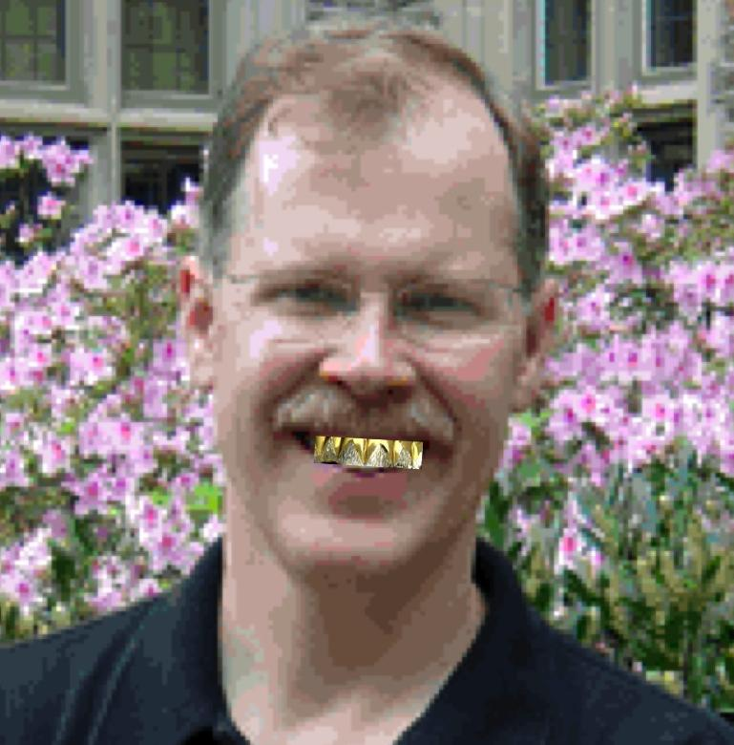
To Recap:
cv
Illustrating: using a text to make your point
Authorizing: establishing the expertise of the text’s author
Extending: putting your own spin on a text
Countering: pushing back against a text

Slide 18
Evidence Ranking* For each claim, rank the provided evidence from 1-4, 1 being the most logical and relevant evidence to support the claim and 4 being the least logical and relevant evidence to support the claim.
Claim: My parents should raise allowance by $5 each week.
Audience: Your parents or caregivers.
___D. According to Kaitlyn Laurie, child and adult psychotherapist in Madison WI, if kids’ allowances aren’t enough it gives kids “the impression things come too hard.”
There is a reference from an adult psychotherapist. This is where you and your students have had practice with this over the past few months.
Go back and code the evidence for the rest of the examples.

Slide 19
Anchor Chart
Now please, work together to begin an anchor chart about what makes logical, relevant evidence.
Notes:
Think and reflect and tie the ends together and think about the larger picture regarding what makes effective logical and relevant evidence to use to support a claim. so you can chart an anchor chart on the wall, at your table, where you are talking through together what makes good evidence. So this is a place where you can help students name the criteria of logical and effective evidence. Hang it in your room and you can come back to this with your students throughout the year. To rethink and revise the characteristics of effective evidence.

Slide 20
What Makes Good Evidence? Anchor Chart
Create an anchor chart to be used in the classroom jot down some ideas that you think belong on this chart:
What makes good evidence?
What would help your students name the criteria of logical and effective evidence?
How and where can you post this chart in classroom so you can come back to it throughout the mini-unit and use it to think and revise and further name the characteristics of good evidence?

Slide 21
Reflect
1. What did you just do?
What are the moves you just made?
What are the things that you did as you were engaging with the other teachers in writing, thinking and talking?
2. How do activities like this move students toward argumentative writing?

Slide 22
Conclusion
Lessons like this in a controlled and supported environment offer students relevant practice
In countering claims, which is something they are likely to do in written texts they come across
In either accepting those claims or pushing back
In looking at evidence and thinking about the connection between the claims and evidence and to which extent the claims are logical and evident
In thinking about the ways they can use that.

