Slide 1
Revision with a Vision: Three Strategies for Students to Become Better at Revising Argument Papers
Barbara A. MacDonald 2015 Advanced Institute Southern Arizona Writing Project

Slide 2
Classroom Challenges in Rewriting
Discuss at your tables the challenges you face in getting students to revise their writing.

Slide 3
Austin’s Butterfly http://bie.org/blog/telling_the_story_behind_a_great_project
As you watch the video, what do you notice about the revision process?

Slide 4
Pair Share
Share with another person your reactions to the video, “Austin’s Butterfly”.

Slide 5
Revising
What is important here is not just the progress Austin makes as he works; we all know that our work gets better when we revise. It is that Austin’s struggles can be used to show other students (and adults) that any difficult and complex task can be achieved if we tackle it in steps and have a team to help us.

Slide 6
Revising
We are all capable of drawing a beautiful butterfly if we start with the basics and add a little detail each time. That’s the story that often gets lost when we display student work. And that is what is important to remember.

Slide 7
What is Revising?
Finding typos? Cleaning up punctuation problems? Completing omissions in your citations? NO! That is editing. As its Latin roots reveal, revision means looking again at your entire work. It requires writers to reconsider the big picture of their drafts. It is looking at a paper like an outside critic and finding opportunities for improving drafts by
cutting,
adding to,
reordering

Slide 8
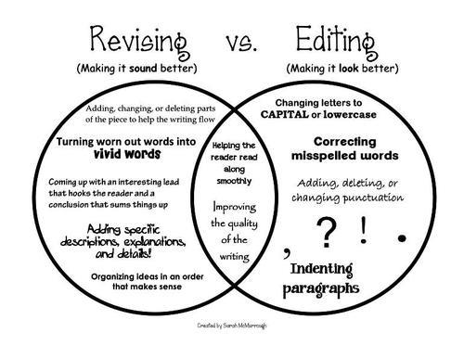
Global Issues Versus Local Issues

Slide 9
What Global Issue(s) would you work on in this paper?
Assignment: Write a paragraph where you compare and contrast chewy and regular Chips Ahoy cookies, making an argument for why one is better than the other.
Chewy Chips Ahoy cookies taste really good. They taste like they just came out of the oven, cause they have that soft, doey texture that you get in warm cookies. Yummm. It almost feels like the chocolate will melt right off the cookie. With the soft cookies, you can also eat them without distracting people, because they dont crunch. You can sneak one during your math class and noone will now. This is why they are good for school. Or your work. When I get a job, I will probly bring chewey chips ahoy to all my meetings. I can give the crumbs to squirrels on my lunch break. Squirrels are my favorite animal. They have such expressive tails. If I could move my butt like that, it would be awesome. In conclusion, chewy chips ahoy cookies are great.

Slide 10
Refer to paragraph on back of demo packet
Global Issues and Local Issues Which global issue would you choose first to mentor the student on the infamous “Chips Ahoy” paper ?
Organize | Purpose | Correct spelling | Signal Phrases
Grammar | Hook | Evidence | Claim

Slide 11
Preparation
Preparation for the “Crazy Claim” paper: Each participant will need a Word Document or paper and a writing utensil.
Directions: Each participant will randomly draw a “Crazy Claim” and spend the next 15-20 minutes writing an argument that contains: a heading, a title, a hook, a “Crazy Claim”, three made up sources (at least of the sources must use authorizing), 2 counter claims, quotations with signal phrases, body paragraphs, a conclusion and no partridge in a pear tree.

Slide 12
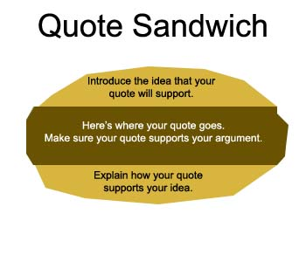
Strategy #1 Arrows or Linking
Turn to this strategy in your packet and read the directions.
Each participant will spend the next 10-20 minutes applying this skill to their papers.

Slide 13
Strategy #1 Arrows or Linking
(CLAIM)The alternative that I think is best for the problem is to send the mentally ill criminals to a rehabilitation center to get them help. (EXPLANATION) I believe that this is needed because it will reduce the amount of people in the jail, and the whole system is basically wasting money sending theses people to jail. (QUOTE WITH SIGNA PHRASE) According to Steve Lopez/LATimes.com/October 5, 2013 “My biggest gripe with the system is why are we spending $50,000 a year to jail somebody when we could be spending $5,000 or whatever it is to put them in a treatment program.” (Middle school article of the week assignment

Slide 14
Claim: Video games do not cause violence.
(QUOTE)“The study looked at 377 vulnerable children who averaged 13 years old. Those children who played violent video games were not seen to exhibit criminal or bullying behavior over that of their non-video game playing peers. A ‘cathartic’ effect was even seen in some children, with aggression and bullying behavior dropping in those who played violent video games” (WebPro). (EXPLANATION) Now not only is there apparently no link to aggression, but now it has a calming effect. Video games were originally created to have a calming effect, to get away from the stresses of our normal everyday lives. So it only makes sense for a video game to have such effects. (Senior research paper on topic of the student’s own choosing.)

Slide 15
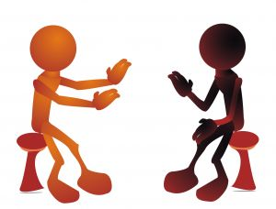
Strategy #2 Crossfire
Turn to this strategy in your packet and read the directions.
Each participant will spend the next 15-25 minutes adding their counter arguments to their “Crazy Claims” rough draft.

Slide 16
Strategy #3 Alien
Turn to this strategy in your packet and read the directions.
Each participant will spend the next 15-25 minutes using the Alien Strategy to see if they met all of the requirements of their first drafts.
Note you can use anything in place of drawing an alien, for example a structure, a place, a thing.

Slide 17
Strategy #4 Global Issues Peer Review
Turn to the strategy in your packet and read the directions.
This is a pair share activity.

