Slide 1
Harris Moves:
Extending
Jessica L. Shumake
SAWP 2015
Advanced Institute
© Marco Pece’s “the wall” via flickr.com
Notes:
Taken on October 8, 2007 by Marco Pece (all rights reserved by the photographer)
https://www.flickr.com/photos/udronotto/1517472773/in/album-72157594520940536/

Slide 2
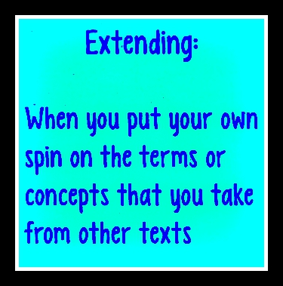
Metaphorical Thinking about Extension
Select What You Want to Extend (No more than 5 per group and no fewer than 2)
Car
Robot
Chili recipe
Human head
Architectural drawing
Paper doll
You will work extending, to build upon and to embrace new perspectives, individually and then within your groups.
Debrief within your small group about why you extended as you did.
Discuss with the large group the key points concerning how particular extensions
impacted subsequent remakes, extensions, or additions.

Slide 3
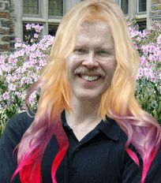
Want to think with others? Put your own spin on their ideas.
What we “have to say is bound up inextricably with books we
are reading . . .and the ideas of the people we are talking with” (2).
Notes:
Harris, Joseph. Rewriting: How to Do Things with Texts. Logan, UT: Utah State UP, 2006.

Slide 4
Extending a Collaborative Story
Using the printed storyboard, read the story ending and write your name at the top of the sheet.
Write what you think happens in the first empty box. You may add simple drawings until the person to your left passes you the next story. Pass as quickly as possible!
Continue passing the comic strip storyboard until everyone has filled in a part of the story and there are no remaining blank boxes. You must build on the earlier information in your extension of the previous storyboard box!
At the end, return the original storyboard to the person whose name is on the sheet.
Take a moment to read your finished storyboard comic and share with a partner in your group.

Slide 5
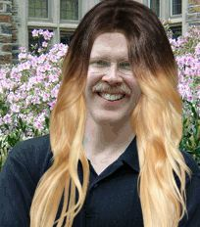
What’s exciting about extending?
“I’d argue that writing tends to become more exciting as it moves outward—selecting, excerpting, commenting and sometimes, changing or inflecting the meanings of other texts” (46).
Notes:
Harris, Joseph. Rewriting: How to Do Things with Texts. Logan, UT: Utah State UP, 2006.

Slide 6
Extensions and Breakthroughs: Cover Songs that Remake Meaning
In his 2003 College English article, Joseph Harris states that he had his biggest breakthrough as a teacher in a basic writing class when he worked with a football player name Timothy, who wrote a sustained analysis of the extensions the Fugees made to Bob Marley’s “No Woman, No Cry.” Timothy argued that the Fugees “shifted and updated the message of the song from a 1960s-style shout of protest to a more current plea for black unity”(Harris 582).
Notes:
Harris, Joseph. “Revision as a Critical Practice.” College English (2003): 577-592.

Slide 7
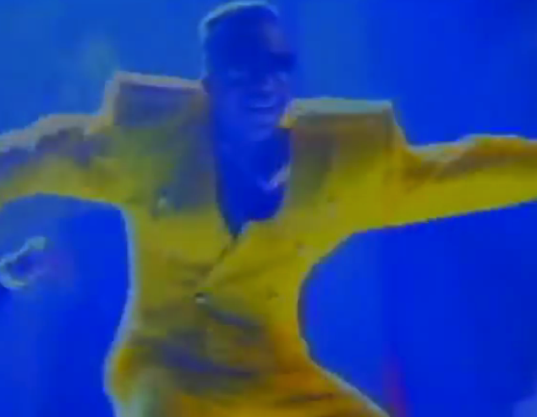
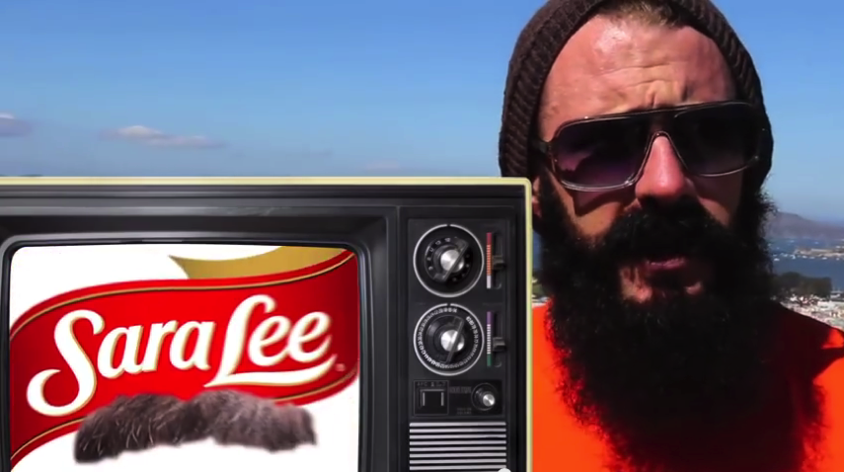
2 Legit to Quit
https://youtu.be/fbdd_Fasz0k
https://youtu.be/wiyYozeOoKs
Notes:
MC Hammer: https://youtu.be/wiyYozeOoKs
Ed Lee: https://youtu.be/fbdd_Fasz0k

Slide 8
Practice Extending a Cover Song in Pairs
Consider the original and the cover.
Does the remake improve the original? Why or why not?
Does one song apply meaning differently in another cultural and/or historical context? If yes, how?
Is there a different root message, spin, or purpose for each song? If yes, what is different?
Which song do you prefer? Why?

Slide 9
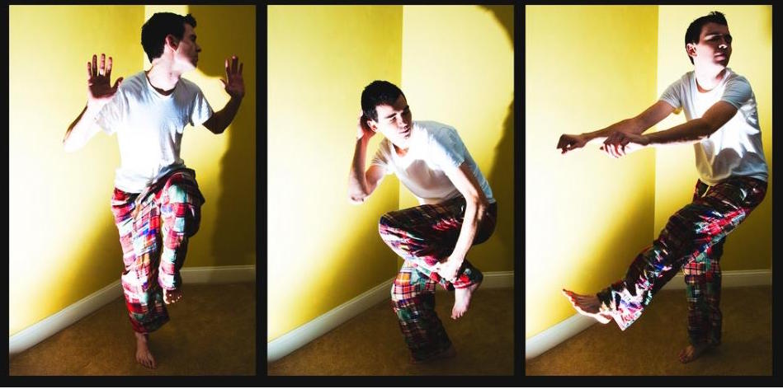
Moves in Extending Original Use
Improve, Add, or Spin Up and Beyond
Dig Down to the Root
Apply Across to a New Context
Notes:
Uptown Funk karaoke: https://youtu.be/MIvbL01uqpU

Slide 10
Variety 1: Extensions that Attempt to Improve or Add Something New
I would also add that .
While is a good starting point, .
Along with ’s point and ’s recommendation, I would further toss in .
The idea can be improved by .
5) Building from this idea, I submit for your consideration that .
6) was good and I would go even further and say .

Slide 11
Variety 2: Dig Down to the Root
1) I agree with and posit that the root of the problem is .
I agree with Salazar’s skepticism and posit that the root of the problem is too many head injuries. I also add that the focus needs to be on concussion prevention during game play rather than fancier gear that gives players incentives to make even riskier moves on the field.

Slide 12
Variety 3: Extensions that Apply Across a New Context
’s idea can also be applied to .
The school board’s idea about renting dunk tanks and placing disliked administrators in those tanks, to raise money for extracurricular activities, can also be applied to our upcoming church bazaar. Few parishoners like Sister Aloysius, and many would pay a lot of money to see her get dunked. If she volunteers to get dunked kids in the parish will then be able to afford to go on a trip to NYC to see Jesus Christ Superstar.

Slide 13
Sample Extension Paragraph
My analysis will extend McGee’s written description of the dish everyone knows as mac and cheese and borrow a term from writer Sarah Etters, who posits that the meal to make is “healthier mac and cheese”—that is a regular box of macaroni and cheese, plus green peas. I would add that during my lifetime, I made both Etters’ healthier recipe and my own protein rich mac and cheese. I submit for your consideration that another way to make mac and cheese healthy is to add both peas and a can of tuna fish. I dub this dish a more balanced meal because of the added protein.

Slide 14
Another Sample Extension Paragraph
“This summer,” Lopez writes, “we’re seeing nearly everything through Harris moves” (8). “Joseph Harris is everywhere,” Darla Oliver adds. “Even though the Beatles said ‘all we need is love.’ I now think all we really need is to put our own spin on the terms and concepts we take from others’ texts.” What Oliver presents as “spin,” I generalize as furthering a thought, idea, approach or concept. This ‘furthering’ requires moving beyond summarizing what others have said by adding your own insights to improve an existing idea or to apply that idea to a new context.

Slide 15
Extending Conversations on Monitoring Teens Online
Read Sengupta’s article “Warily, Schools Watch Students on the Internet.” Put note or highlight where you want to extend in some way.
Answer the discussion questions from Schulten (work individually and then we’ll discuss together in large group).
Use the Three Varieties of Extending Chart to select and extend two quotations from Sengupta’s article. Do one column of the chart first as a group.
Use the Three Varieties of Sentence Starters to practice the Harris move of extending in a brief paragraph concerning monitoring teens online.

Slide 16
Sample Paragraph that Extends “Schools Watch Students on the Internet”
It would seem that there are a lot more ways for teens to get into legal trouble at school in the 21st century. Whereas there was always the risk of a note being intercepted or a whisper carrying to the ears of an unintended listener before the advent of text messaging and social media sites, as school district lawyer Gretchen Shipley articulates, “the ability to monitor is growing so quickly.” It would seem that the phenomenon of monitoring students is on the increase and with a big price tag. By the end of 2013 more than 3,000 schools were paying Geo Listening approximately $40,500 each year to “observe” students’ public social media posts. David Jones, president of Geo Listening’s competitor, CompuGuardian, argues that his technology helps schools to detect which “students are having problems.” While Jones specifically mentions students researching search terms such as ‘anorexia’ or how to ‘build a bomb,’ Jones’ idea can also be applied to students who are asking an array of questions about topics that arouse teens’ curiosity. Building from this idea, I submit that we need to begin teaching students how to protect themselves from the prying eyes of school administrators through digital tools such as private browsing in Incognito mode and using programs such as TextSecure.

Slide 17
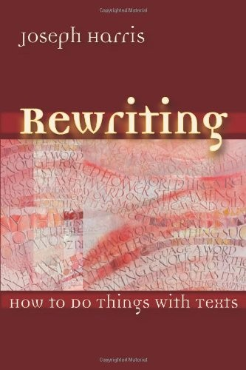
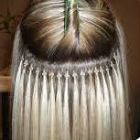
Harris Moves Recap on Extending
“Define the projects of other writers in a fair and generous way, so that you can make use of the source” (Harris 19).
In forwarding a text, you’re extending its uses (Harris 38).
Writers don’t make moves in isolation (Harris 49).
Notes:
Harris, Joseph. Rewriting: How to Do Things with Texts. Logan, UT: Utah State UP, 2006.

