Slide 1
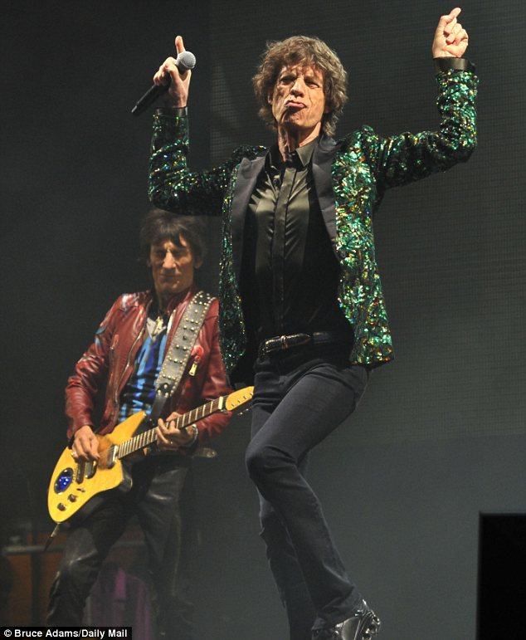
I’ve Got Those Moves Like…

Slide 2
Joseph Harris in Moves that Matter in Writing
Let’s concentrate on four moves: illustrating, authorizing, extending, and countering.

Slide 3
1. Illustrating
Look to other texts for examples of a point you want to make.
Scenario: Two friends are deciding whether to go see Guardians of the Galaxy.
Adriana: I don’t know. I don’t really want to go.
Matt: But it’s supposed to be so good! Come on!
Adriana: Eh, I just don’t feel like it. I saw the preview, and it looked boring.
Matt: Boring? That’s totally not what I heard. Plus. . .
Notes:
92% Fresh on Rotten tom

Slide 4
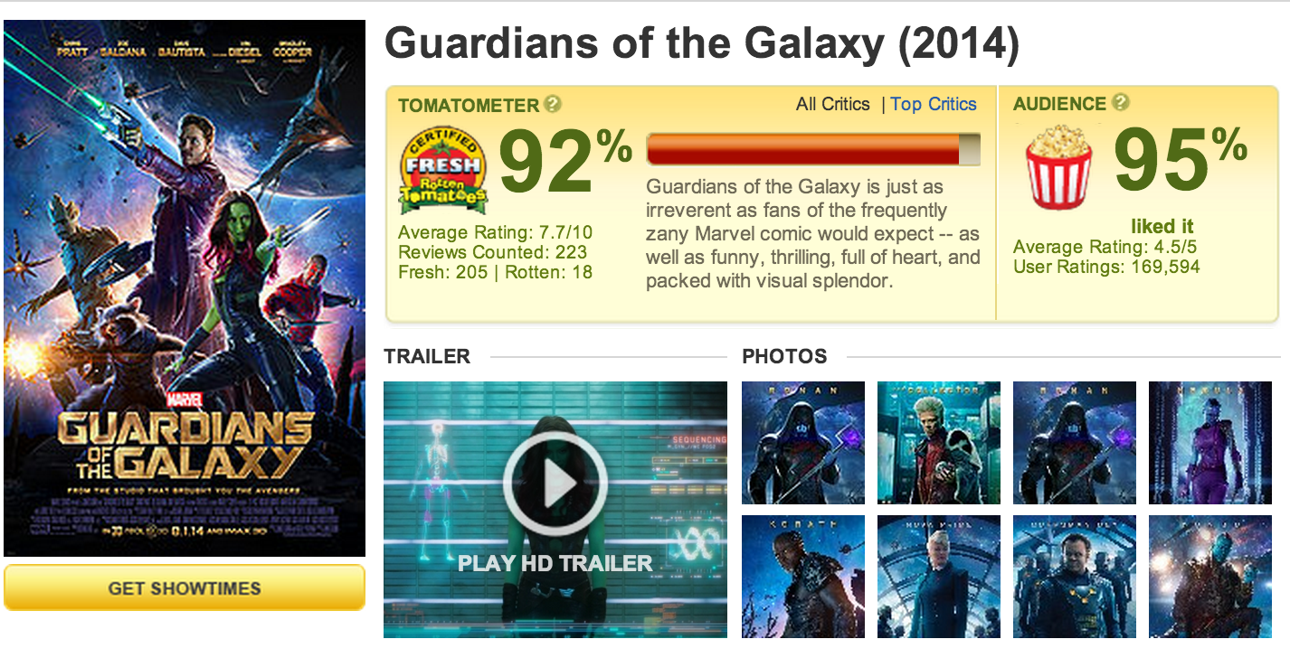
. . .Rotten Tomatoes gave it a 92%!
Adriana: Wow, really?
Matt: Yeah, and the Rotten Tomatoes audience ranked it 95%!
Adriana: Well, in that case, yeah, okay. Let’s see it!
TEXT

Slide 5
2. Authorizing
When you invoke the expertise or status of other writers to support your thinking.
Scenario: Two friends are deciding whether to go work out at the gym.
Maria: I don’t feel like working out today. Let’s just skip it.
Jenny: Yeah, I’m totally unmotivated too. But we probably should. . .
Maria: We could just go tomorrow instead.
Jenny: I hear you, but working out is good for us. Plus. . .

Slide 6
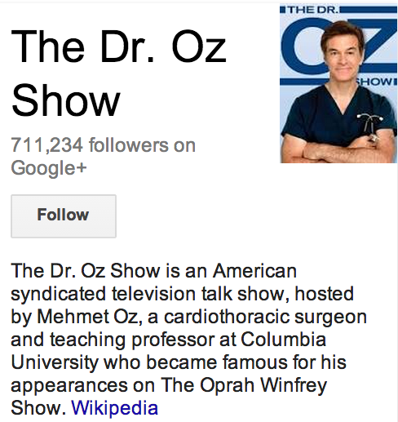
. . .well, you do know who Dr. Oz is, right? That cardiothoracic surgeon who promotes health?
Maria: The famous guy from Oprah?
Jenny: Yeah, that’s him. Well, he says that cardiovascular exercise is super-beneficial.
Maria: Does he really?
Jenny: Yep. And if Dr. Oz says it’s
good for us, we should probably go.
Maria: Yeah, I guess you’re right.
Let’s head out now!

Slide 7
3. Extending
When you put your own spin on the terms or concepts you take from other texts.
Scenario: Two students are brainstorming
ways to raise money for their senior class trip.
Bev: According to this “Fundraising 101” pamphlet, a good way to raise money is by renting a dunk tank.
Brian: Yeah, that seems like a decent starting point, and I bet we could make even more money if we put our own spin on it.
Bev: What do you mean?
Brian: Well. . .

Slide 8
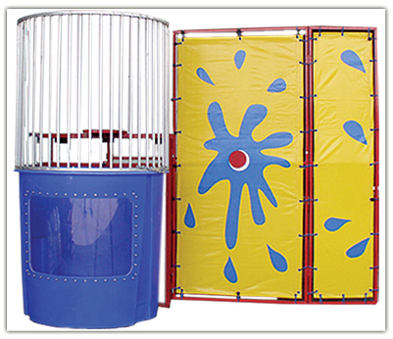
. . .how about instead of filling it with just plain water, we add jellyfish?
Bev: Great idea! The students would pay big-time to watch Mrs. Sourgrouch get stung over and over again! Hey, we could even get a second dunk tank!
Brian: And fill it with what?
Bev: Piranhas!
Brian: Awesome idea! Man, we’re
going to make so much money!

Slide 9
4. Countering
When you “push back” against the text in some way (identifying fallacies in the writer’s argument, for example).
Scenario: A young couple is debating whether to adopt a family of hyenas.
Betsy: I don’t think it’s such a good idea, Lance. I just read Hyenas: The Hidden Dangers, and it makes a compelling argument that hyena ownership isn’t for everyone. Hyenas are hard to housetrain and costly to feed, and they carry disease.
Lance: That’s true. . .

Slide 10
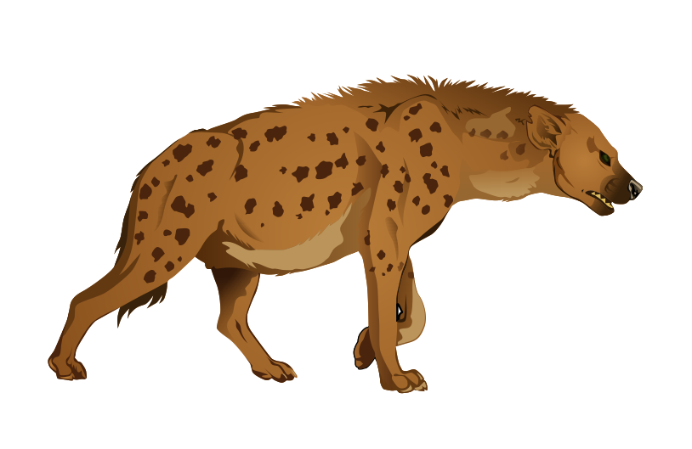
. . .BUT Sparky was difficult to housetrain too, right? He continued to have accidents on the rug for years, but we still loved him. And as for feeding the hyenas, we have a pretty bad feral cat overpopulation problem in our neighborhood. This sounds like the perfect solution.
Betsy: I don’t know. . .
Lance: Look, name one disease that hyenas carry that you don’t already have.
Betsy (pauses to think): Okay, you’ve got a point. Tell you what, how about we contact Homes for Hyenas
first thing in the morning?
Lance: See? I knew you’d
come around!

Slide 11
To: JacksonTeacher@yahoo.com
Subject: I DESERVE AN A
Dear Ms. Jackson,
I got a C on this analysis paper, and I think it should be an A.
I have analysis! See on page three, I say, “The chair represents his inner angst.”
In your final comments, you said, “This paper lacks sufficient evidence from the text,” but that’s totally not true. I quote from the text a lot.
And furthermore, I turned this in last year to Ms. MacDonald, and she has two masters degrees, she attended the SAWP institute on writing, and she presents at conferences for the National Writing Project. And SHE gave it an A.
Sincerely,
Gabby Gradegrubber

Slide 12
Your Turn
Pair up.
Draw a slip from the hat.
Create a skit demonstrating your chosen Harris Move.
Perform skit in front of group. Audience will try to guess the move you’re demonstrating
Hint: feel free to make up “sources” for your claim.

Slide 13
To Recap:
cv
Illustrating: using a text to make your point
Authorizing: establishing the expertise of the text’s author
Extending: putting your own spin on a text
Countering: pushing back against a text

Slide 14
The End

