Slide 1
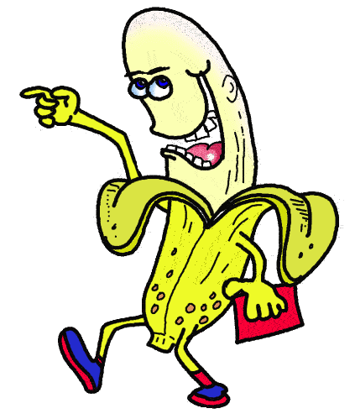
Just Joking
Exploring Humor and Stereotypes through Argument Writing
Cathy Sproul, Summer 2015
Southern Arizona Writing Project

Slide 2
The following slides contain jokes.
As you view/read each one, think about:
1. your gut reaction to the joke
2. the assumptions and/or stereotypes the jokes play on
3. the joke’s funniness (or lack thereof)

Slide 3
Welcome to being a parent of a teenager. Prepare for excessive eye rolling, emotional outbursts, and thoughts of running away. And that’s just the parents.

Slide 4
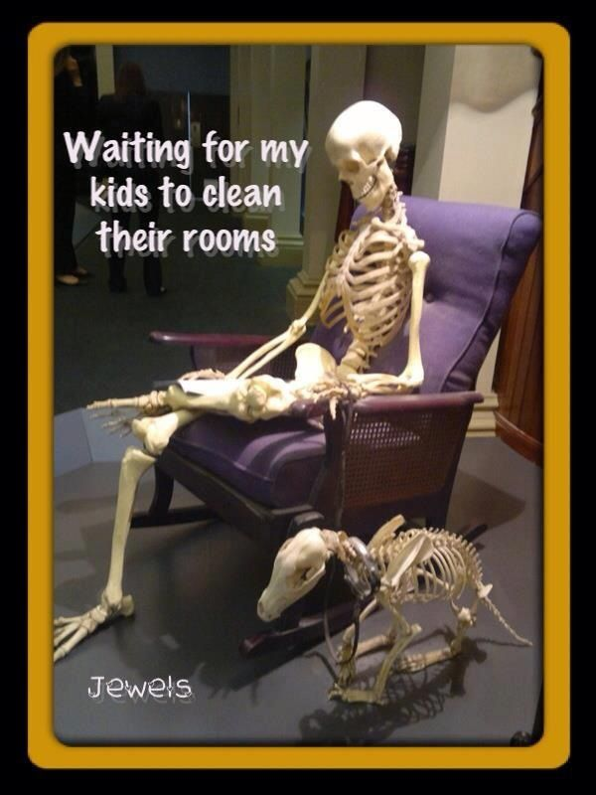

Slide 5
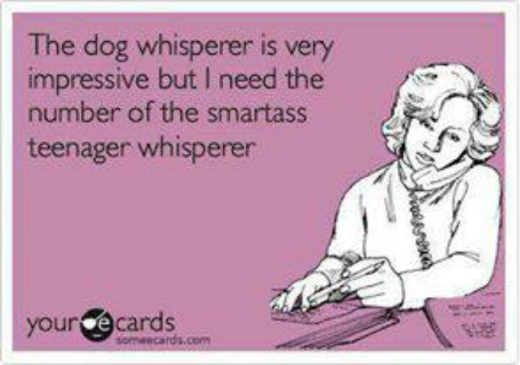
The dog whisperer is very impressive, but I need the number of the Smartass Teenager Whisperer.

Slide 6
Sexual education classes in school should just be listening to a baby cry for five straight hours while watching the same cartoon on repeat.

Slide 8
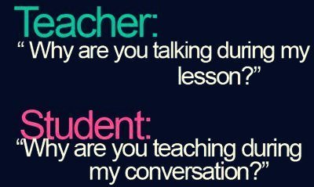

Slide 10
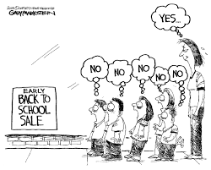

Slide 11
My teacher pointed at me with his ruler and said: “At the end of this ruler there’s an idiot!”
I got detention after asking which end.

Slide 12
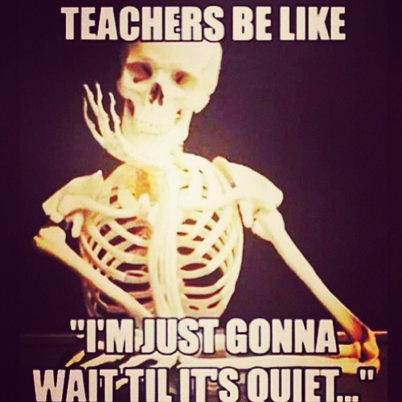

Slide 13
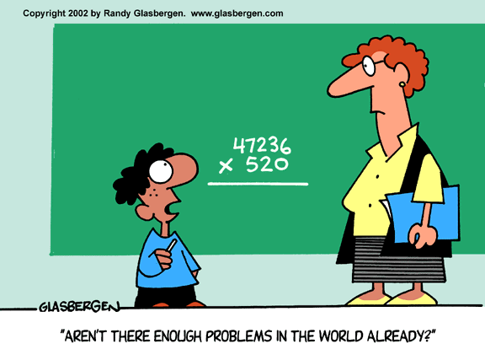

Slide 15
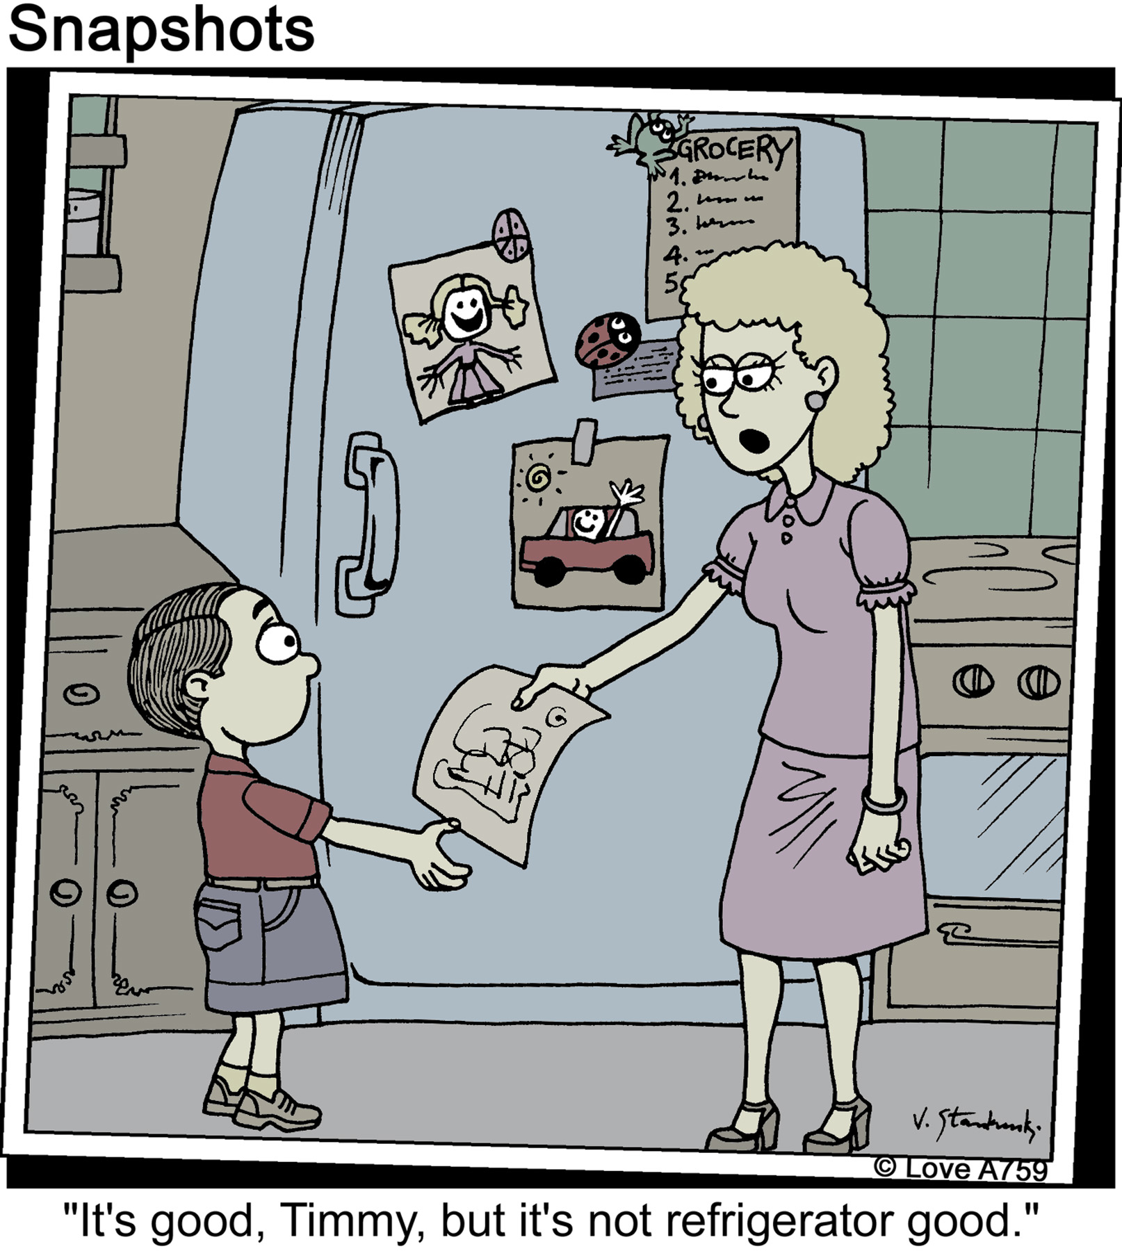

Slide 16
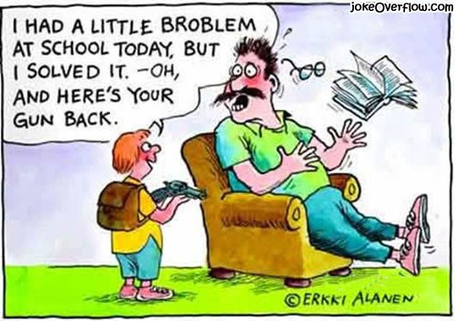

Slide 17
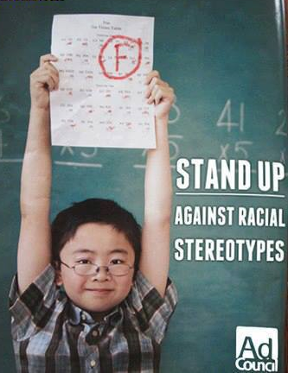

Slide 19
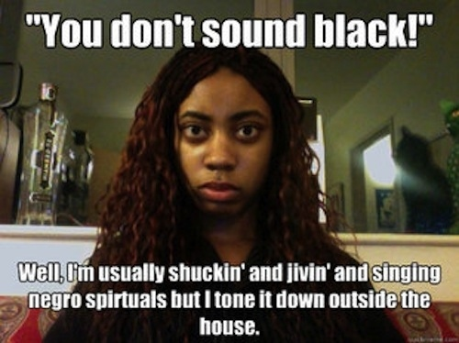

Slide 20
How many white people does it take to change a light bulb?
None, they just beat up the room for being black.

Slide 21
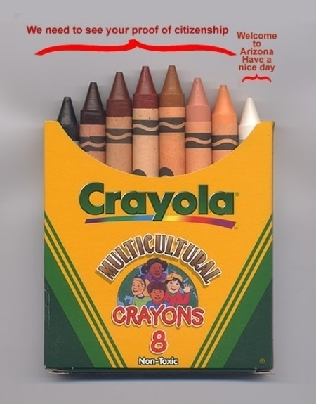

Slide 22
My grandfather did not travel 4,000 miles across the Atlantic Ocean to see this country be overrun by immigrants.
—Stephen Colbert

Slide 23
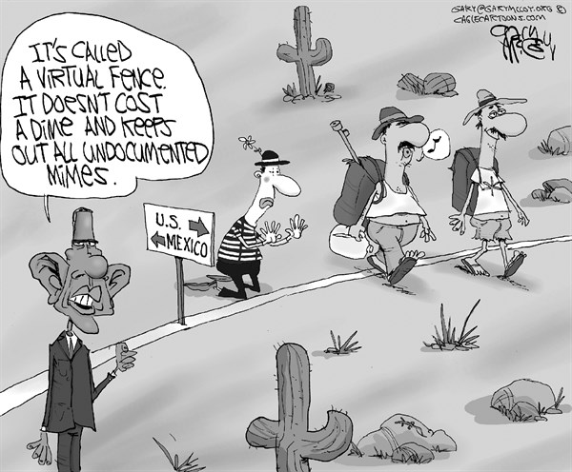

Slide 24
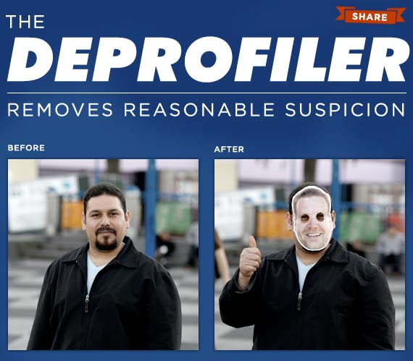

Slide 25
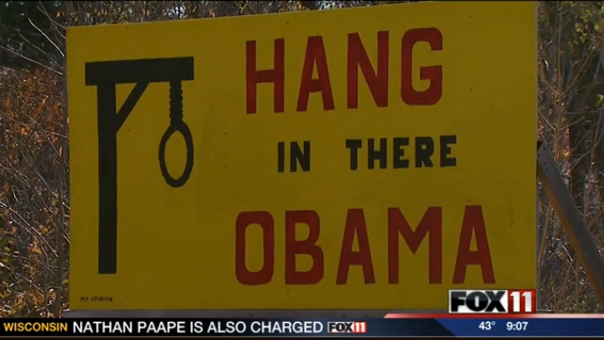

Slide 26
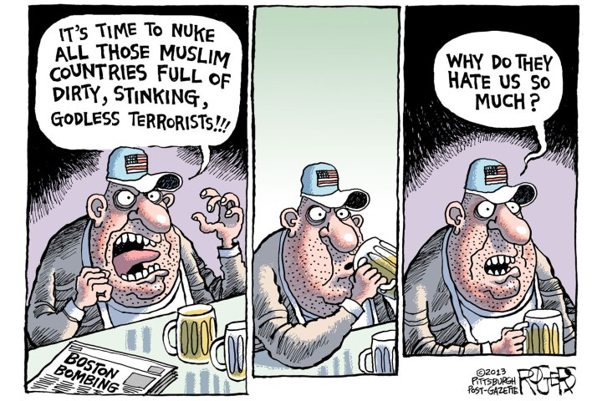

Slide 27
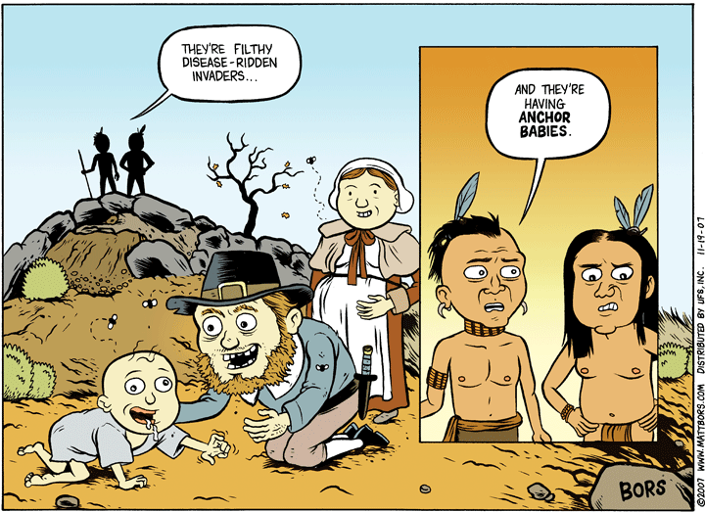

Slide 28
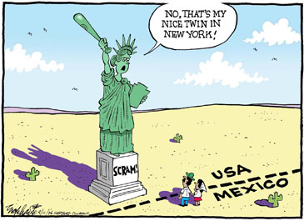
No, that’s my nice twin in New York.

Slide 29
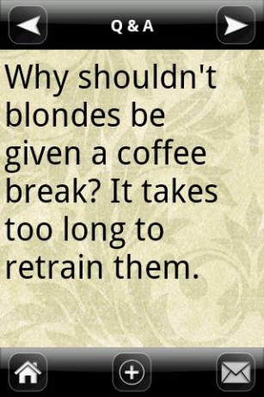

Slide 30
Why are blonde jokes short?
So men can remember them.

Slide 31
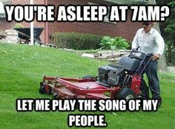
LET ME PLAY THE SONG OF MY PEOPLE

Slide 32
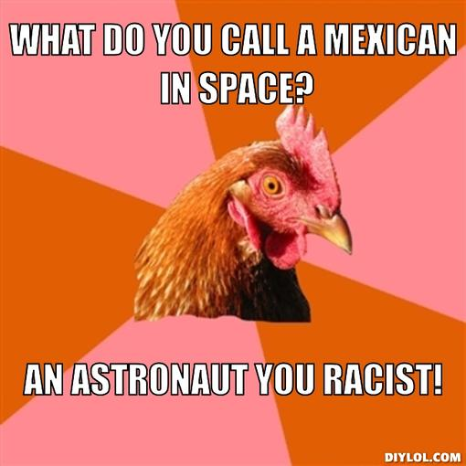
,

Slide 33
Writing Activity
Pick a joke (or two or three) that sticks out in your mind
Think about the joke(s). What was your gut reaction? What assumptions/stereotypes does the joke make? Was the joke funny to you? Why or why not? Write!

Slide 34
The End

