Slide 1
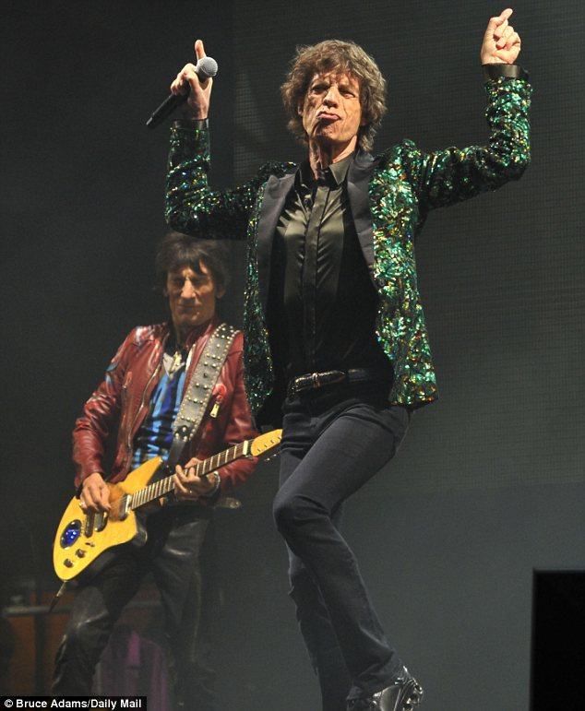
I’ve Got Those Moves Like…

Slide 2
Joseph Harris Moves that Matter in Writing

Slide 3
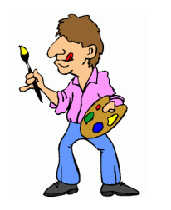
Illustrating
Look to other texts for examples of a point you want to make.
Notes:
92% Fresh on Rotten tom

Slide 4
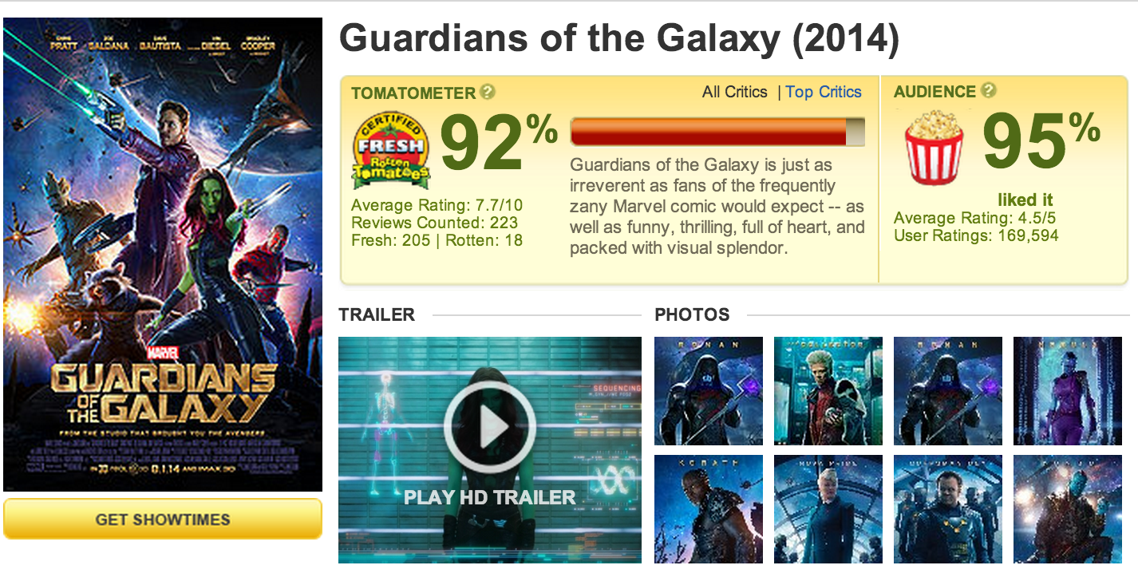

Slide 5
Authorizing
When you invoke the expertise or status of other writers to support your thinking.

Slide 6
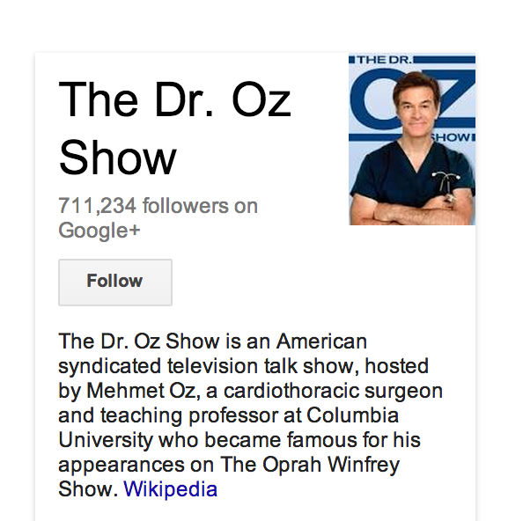

Slide 7
Extending
When you put your own spin on the terms or concepts you take from other texts.

Slide 8
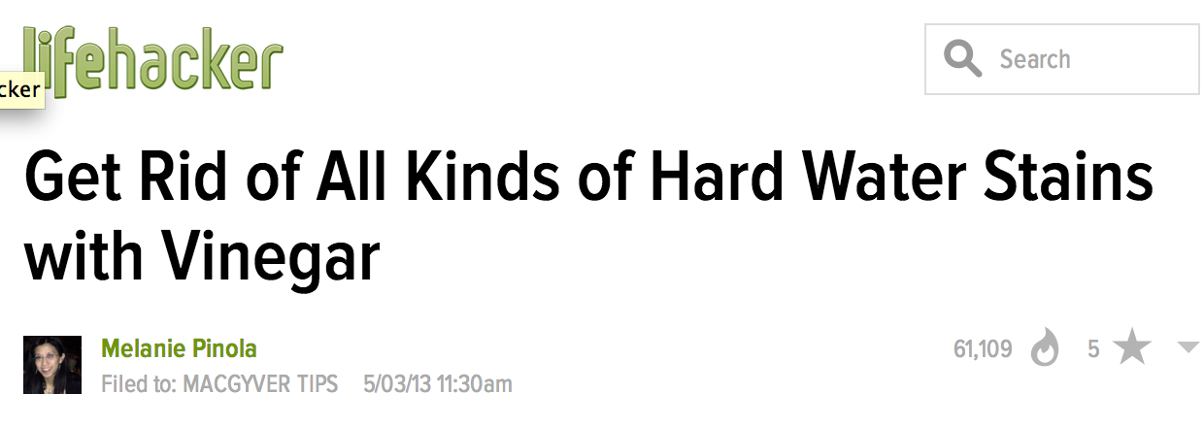

Slide 9
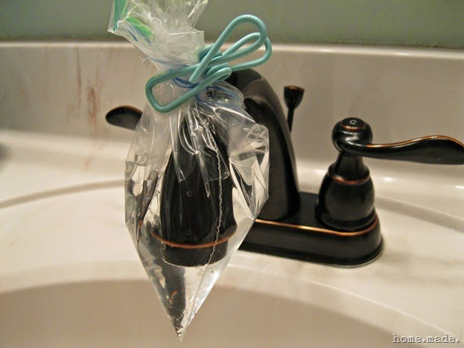

Slide 10
Countering
When you “push back” against the text in some way (identifying fallacies in the writer’s argument, for example).

Slide 12
To: JacksonTeacher@yahoo.com
Subject: I DESERVE AN A
Dear Ms. Jackson,
I got a C on this analysis paper, and I think it should be an A.
I have analysis! See on page three, I say, “The chair represents his inner angst.”
In your final comments, you said, “This paper lacks sufficient evidence from the text,” but that’s totally not true. I quote from the text a lot.
An furthermore, I turned this is last year to Ms. MacDonald, and she has two masters degrees, she attended the SAWP institute on writing, and she presents at conferences for the National Writing Project. And SHE gave it an A.
Sincerely,
Gabby Gradegrubber

Slide 13
Your Turn
Each group creates a short skit based on the Harris move they draw from the hat. Try to use the move in everyday circumstances, and don’t tell us what it is (we will guess!).
Feel free to make up “sources” for your claim.

