Slide 1
On April 18, 2015 renowned sloth owner Christopher McGee was arrested on charges of administering illegal steroids to his prized racing-sloth, Lightning. Sloth racing has become the new fad in animal racing, providing a calm, quiet atmosphere in comparison to other similar events such as horse and greyhound racing. Sloth racing has highly competitive events drawing large crowds, betting pools, and proceeds that go towards wild sloth preservation. Lightning has won several titles, including the elite Molasses Derby Championship, raising thousands of dollars for his wild cousins, and now, due to the allegations against his owner and trainer, such titles are under scrutiny. Due to the short life of steroids in the sloth’s system, lab testing on Lightning was inconclusive.
The Case

Slide 2
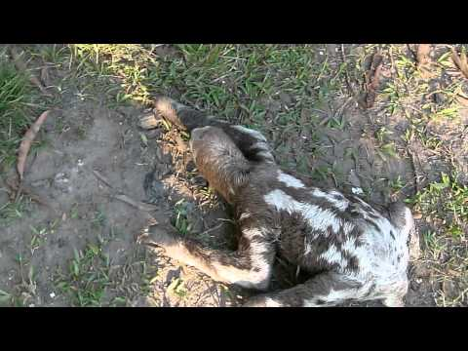
Video: Sloth Crawling

Slide 3
On April 18, 2015 renowned sloth owner Christopher McGee was arrested on charges of administering illegal steroids to his prized racing-sloth, Lightning. Sloth racing has become the new fad in animal racing, providing a calm, quiet atmosphere in comparison to other similar events such as horse and greyhound racing. Sloth racing has competitive events drawing large crowds, betting pools, and proceeds that go towards wild sloth preservation. Lightning has won several titles, including the elite Molasses Derby Championship, raising thousands of dollars for his wild cousins, and now, due to the allegations against his owner and trainer, such titles are under scrutiny. Due to the short life of steroids in the sloth’s system, lab testing on Lightning was inconclusive.
The Case

Slide 4
Sloths and Princesses
http://www.buzzfeed.com/jenlewis/slotherella?utm_term=.ohanQVEap&sub=3390631_3400351

