Slide 1
They Say/I Say: The Secret Ingredient
in Academic Writing
Melissa Bergman and Jess Shumake
Notes:
https://www.google.com/search?q=google+images+candied+yams&espv=210&es_sm=91&source=lnms&tbm=isch&sa=X&ei=mwUYU4OyNOTlyAGVl4HoCw&ved=0CAkQ_AUoAQ&biw=1024&bih=394&dpr=2.5#q=candied%20yams&tbm=isch&facrc=_&imgdii=_&imgrc=DaDUtb9sSEAvOM%253A%3Bnl7nzYP4ysExqM%3Bhttp%253A%252F%252Fsweetiepiess.com%252Fwp-content%252Fuploads%252F2013%252F04%252FMiss-Robbies-Candied-Yams-and-Green-Beans-Recipe.jpg%3Bhttp%253A%252F%252Fsweetiepiess.com%252Fmiss-robbies-candied-yams-recipe%252F%3B1600%3B1260

Slide 2
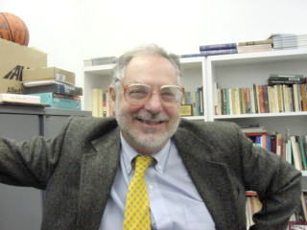
Gerald Graff give us the recipe

Slide 3
What do “they” say? Take me to the text .
Notes:
Read Graff and consider application of his idea of entering the conversation as the secret sauce. Verbalize impressions, response, first thoughts.

Slide 4
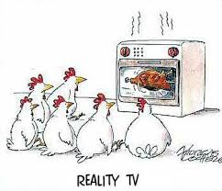
Quick-write
What are your thoughts about reality TV?
Notes:
Two minute free-write. Turn to a partner and determine who has the fewest TV sets. The person with the fewest television sets begins. One minute each pair/share.

Slide 5
Notes:
3-4 minutes
T-Chart:
Create two columns – one for images and one for words. What are you noticing? What opinions are you generating from this image?
Do a group share and create a chart.
Note that we’ll try a different invention strategy to come up ideas for each text.

Slide 6
“And now I’m thinking…”
Go back to your Quick Write about reality TV.
Use a transition like “Now I’m thinking,” and then select a detail from the text (the image) to add to your quick-write about reality TV.
We are starting a process call “layering.” We’ll layer texts and writing several times.
Notes:
Two minute free-write. Partner share what you added after you studied the advertisement.

Slide 7
The Thinking Behind Layering
Notes:
Connecting texts, not just summarizing
Considering different angles
Changing our claims and our minds as we write

Slide 8
NEXT: We continue playing around with how an idea might change.
Read the WIRED article “Why Reality TV Doesn’t Suck.”
Code the text for ways to respond “yes, no, but”
Notes:
Distribute copies of these readings from the WIRED.

Slide 9
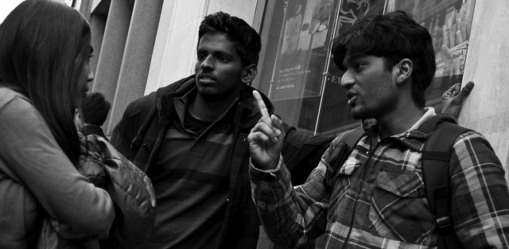
Join the Conversation
Respond to the text by writing what you are thinking now. Add another layer.
Notes:
In your classroom, you can be more directive if needed, by using sentence starters. Share copies of sentence starters
Time for low-stakes writing allows students to take risks.
Three minute free-write. Reread the whole thing to yourself to see if it hangs together.

Slide 10
Pausing to Consider the Evolution of Our Thinking…
Concerning argument writing,
I used to think…
But then (this happened)…
And now…
Share with a partner. What are your ideas and what did you pull from the other texts?
Notes:
Pausing to reflect how thoughts may have changed or shifted

Slide 11
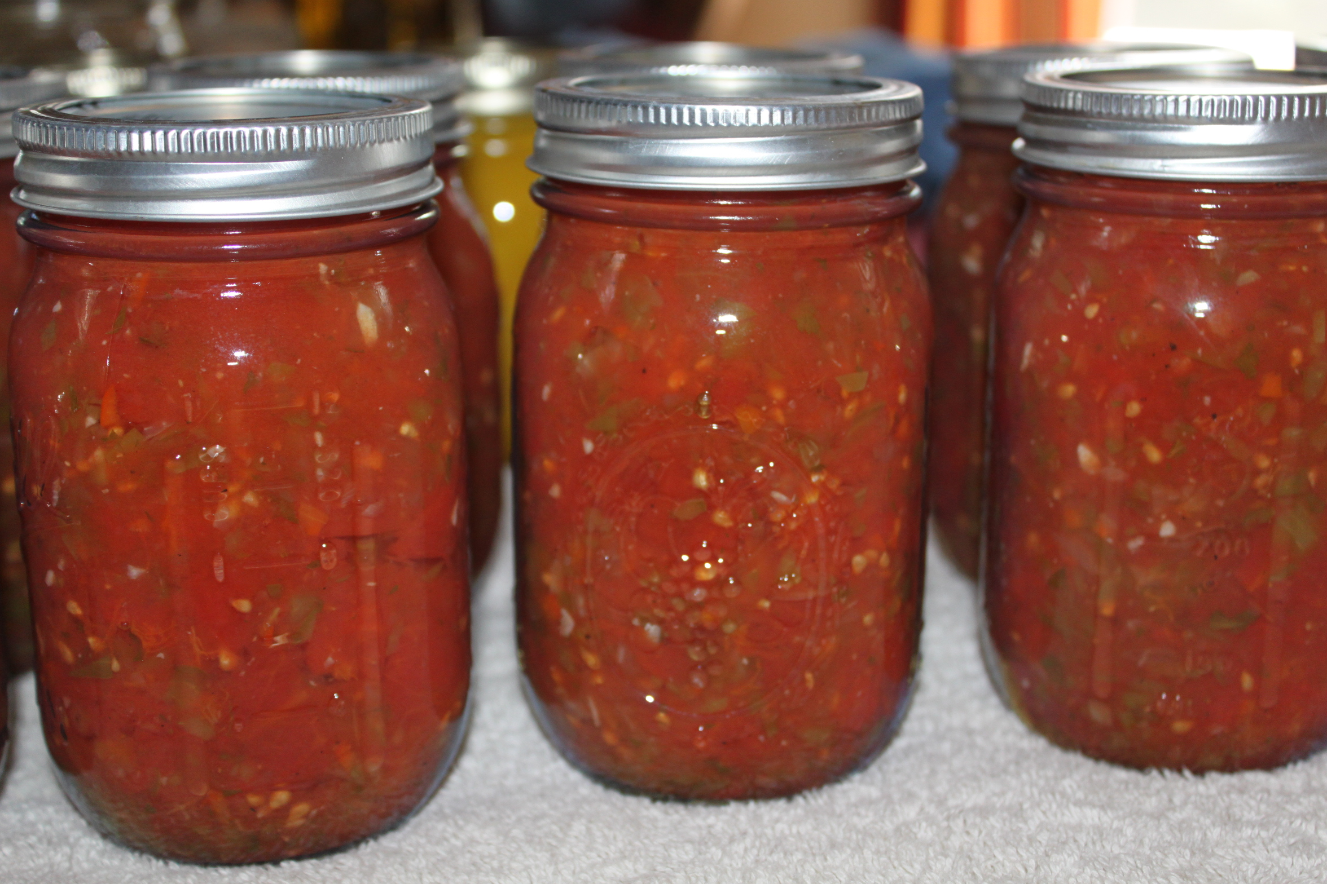
Snapshot of the They Say/I Say “Secret Sauce”
Quick share: How did this process work for you and how might it work in your classroom?

